Slide 1
Asian Restaurant in Austin
By George Landsly

Slide 2
Introduction
Problem: find an optimal location to open an Asian restaurant in Austin, Texas.
find locations that are not already crowded with restaurants
find areas with no or minimal Asian restaurants in the vicinity
assume that being closer to the city center is better
Data Needed
number of existing restaurants in the neighborhood (any type of restaurant)
number of and distance to Asian restaurants in the neighborhood, if any
distance of neighborhood from city center

Slide 3
Data Acquisition
Acquisition Methods
Austin's center coordinates will be obtained using Google Maps API geocoding
centers of candidate areas will be generated algorithmically and their approximate addresses will be obtained using Google Maps API reverse geocoding
number of restaurants, their type and location in every neighborhood will be obtained using Foursquare API

Slide 4
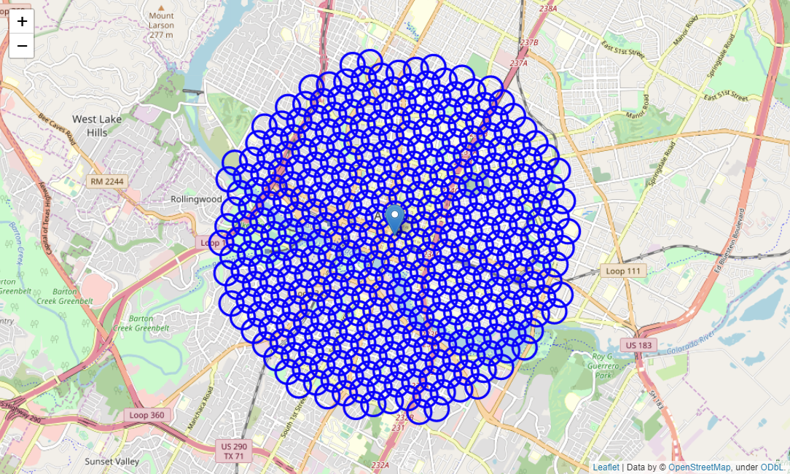
Building Neighborhoods with Google

Slide 5
Foursquare
Total number of restaurants: 410
Total number of Asian restaurants: 91
Percentage of Asian restaurants: 22.20%
Average number of restaurants in neighborhood: 2.5961538461538463
Fast food was filtered out of these results, but potential outlier subcategories were not (Mongolian, Indonesian, etc.).

Slide 6
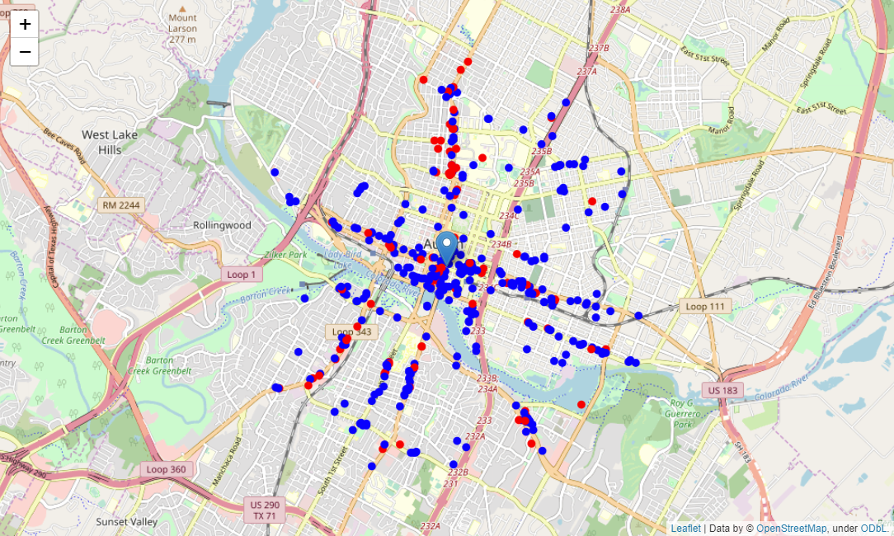
Restaurant Density

Slide 7
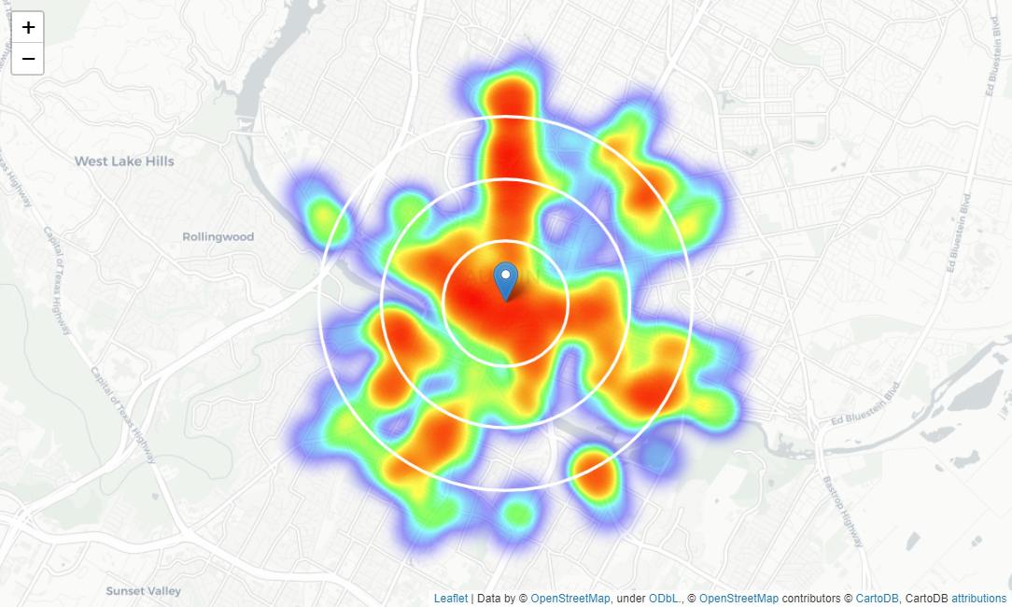
Identifying Areas of Interest

Slide 8
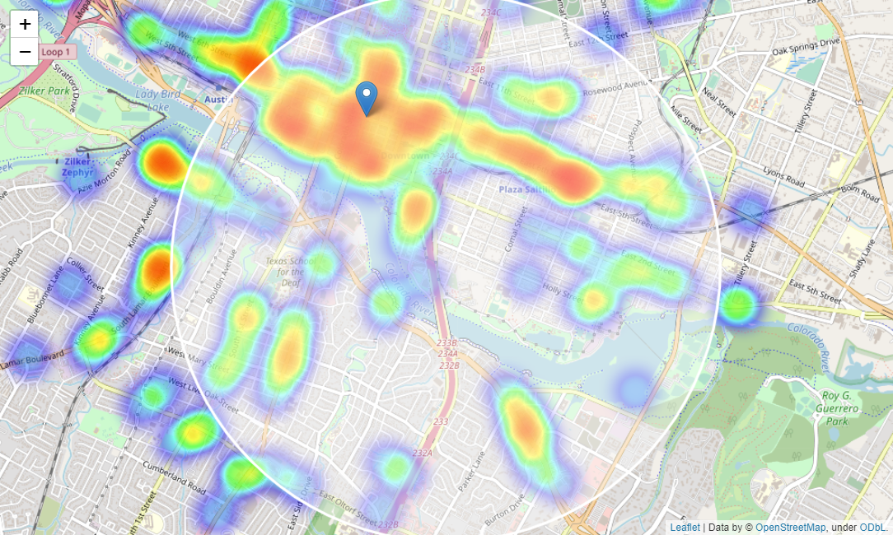
Focusing South

Slide 9
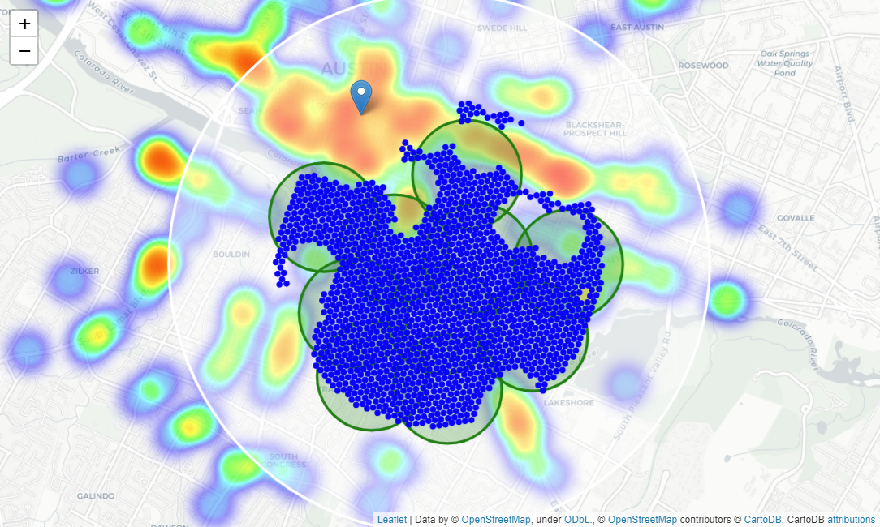
Clustering

Slide 10
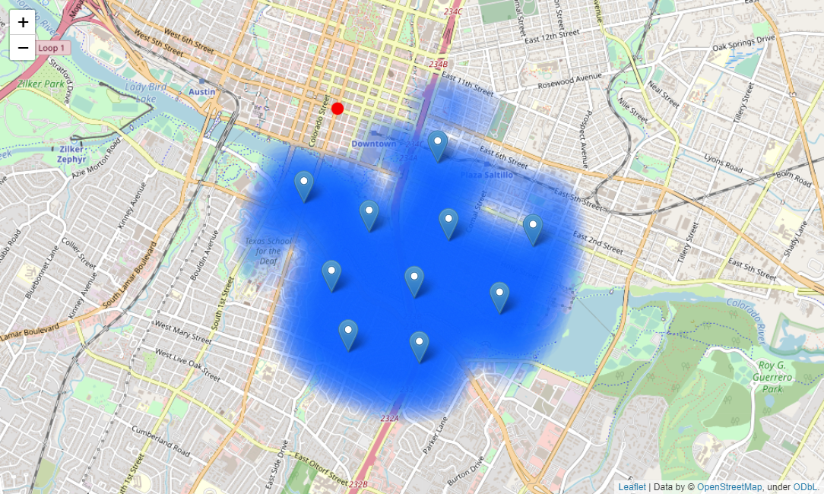
Centers of Interest

Slide 11
Results
2010 Canterbury St, Austin, TX 78702
1208 Newning Ave, Austin, TX 78704
43 Rainey St, Austin, TX 78701
1301 N Interstate 35 Frontage Rd, Austin, TX 7874
Ann and Roy Butler Hike and Bike Trail, Austin, TX 78741
1405 Holly St, Austin, TX 78702
300 S Congress Ave, Austin, TX 78704
1100 E 3rd St, Austin, TX 78702
1505 Alta Vista Ave, Austin, TX 78704
2101 Jesse E. Segovia St, Austin, TX 78702

Slide 12
Conclusion
There is ample opportunity to open an Asian restaurant in Austin at a prime location with minimal competition.
Final decision should be made using the results alongside other criteria.
Additional information should be gathered on:
real estate availability
prices
average consumer income
community interest
general location appeal.

